Slide 1
AHST Interim Career Framework Non-Degree
May 2026

Slide 2
Overview
Implementing the ICF has been a significant undertaking.
We have been trying to move fast as possible, understanding there were dependencies and competing priorities across our system. We acknowledge that this has taken significantly longer than we anticipated.
Our intention with the ICF is to get greater consistency in the placement of roles on the new designated salary scales
  ICF is an interim step in our journey towards an established career framework based on evidence from the new job evaluation methodology

Slide 3
ICF Mapping
Intent: To address anomalies that arose from pay equity translations for designated roles
  About existing designated roles, it's not about creating new designated roles.
  Focus is on the role, not the person therefore, different from the pay equity process.
Professions not included in PE/ICF implementation:
  Sonographers, Psychologists, Medical Physicists, MRI and Nuclear Medicine, Perfusionists.
Minimum steps as a result of previous agreements will be applied.

Slide 4
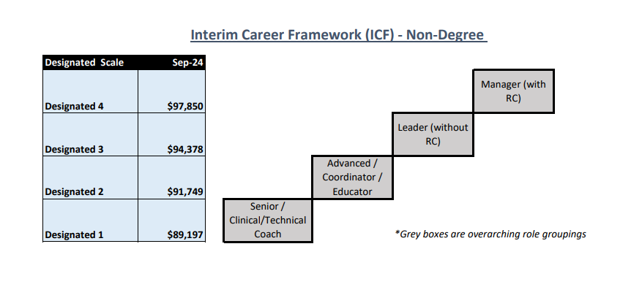
Non-Degree ICF Scale
[Non-degree scale image to be inserted]

Slide 5
FAQs Mapping considerations
Q: What are the mapping considerations?
A: The mapping process considers the requirements of the role. An individual’s job title is not the determining factor of where a role will be placed – ICF uses overarching role groupings to describe roles with similar characteristics (umbrella term)

Slide 6
FAQs– Roles and responsibilities
Q: Who leads the mapping process at a district level?
A: To help ensure consistency at district level, the district Chief Allied Health Officers will have oversight of the mapping process.
Q: Who else is involved in confirming mapping?
A: CAHST/their office will work with Operations Managers, with input from line managers and unions. HR support is needed, and BI support may also be required.

Slide 7
FAQs - Scope
Q: Does my current job title determine whether my role is designated or where it fits on the ICF?
A: No. Current role titles are not used to determine designation or ICF placement. The ICF implementation is for roles that are already designated, with a designated position description. Each role is assessed against the framework on its actual functions and scope.
Q: I do work that is outside my position description and in the past, I’ve completed merit/CASP, will this extra contribution be recognised?
A: The mapping is based on service need and the requirements of the role, not the capability of the person in the role.
The progression rules and the Guidelines of Expectation of Professional Practice (GEPP) in the pay equity settlement replace any previous Merit and CASP systems that were in place prior to settlement.

Slide 8
FAQs – Scope cont.
Q: Can mapping be used to create new designated roles?
A: No. This is not a service design process and is not a mechanism to create new designated roles; the process is limited to mapping existing designated positions to the ICF.
Q: Could mapping my role to the ICF mean I go down in grade or pay?
A: No. No individual will have their pay reduced as a result of mapping roles to the ICF. If your role is mapped to a lower grade, your current salary will be held until the rates of the correct band exceed your salary
Q: What if mapping results in a higher designated grade for my role?
A: If mapping leads to upward movement, the individual will begin at the new grade with anniversary dates taken into consideration.

Slide 9
FAQs – Scope cont.
Q: What happens to roles that were already scoped before the ICF?
A: These are mapped to the equivalent role within the ICF to ensure consistency.
Q: What if the specified grades in the Collective Agreement differ from ICF mapping?
A: Collective Agreement grade specifications take precedence over ICF mapping for particular roles.
Q: How is rural working recognised in the ICF?
A: Rural working requirements are considered within each role rather than being treated separately.

Slide 10
Quality assurance
Q: How will national consistency be ensured?
A: The National Chief AHSTs met recently to sense-check and moderate decisions, ensuring consistency across the data.
Q: Is there a reconsideration process if someone disagrees with mapping?
A: Yes. A national reconsideration process will be in place. Unions will be involved in this process.

Slide 11
Non-Degree Scale – Mapping & Quality Assurance
Activity | Status
Role mapping | Complete
Quality assurance on data | Complete
Data shared with unions for visibility | This week
Data submitted to payroll | Alongside degree scale
Staff notifications of outcome | To begin early June

Slide 12
Payment Schedule
Non-degree scale payments will follow the same schedule as the degree scale implementation.
[Payment schedule to be uploaded to Te Haerenga]

